Slide 1
MongoDB Commands

Slide 2
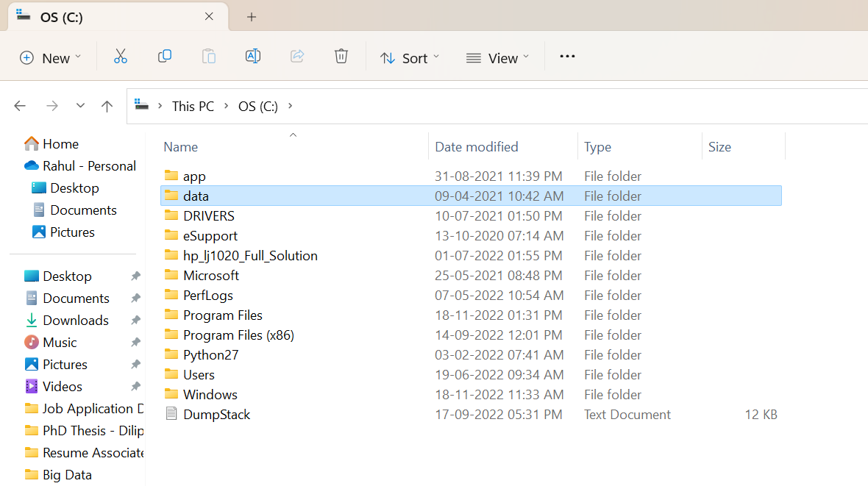
Installation
Link for download:
MongoDB Community Server
Search on google for “MongoDB for Windows” for updated version
Create a folder “data” in c: drive

Slide 3
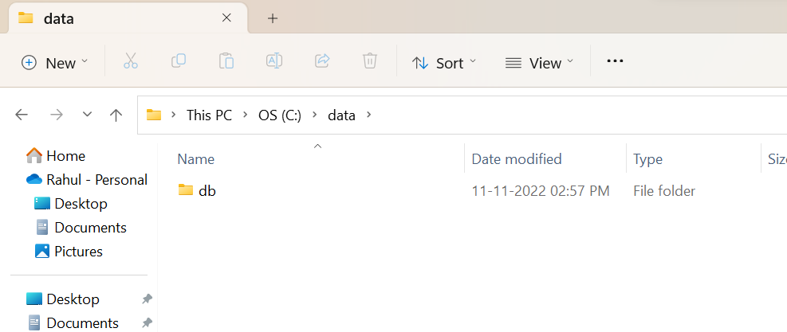
Installation
Link for download:
MongoDB Community Server
Search on google for “MongoDB for Windows” for updated version
Create a folder “data” in c: drive
Create a folder “db” in this newly created folder data

Slide 4
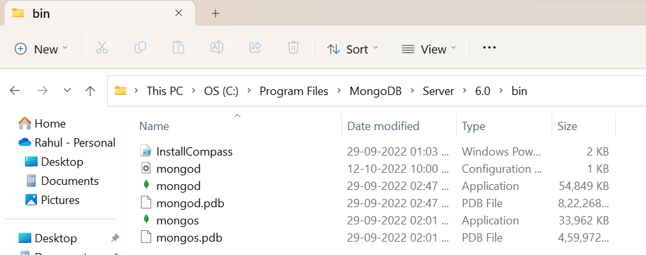
Run
Go to c: drive
Go to program files
Go to MongoDB
Go to Server
Go to 6.0
Go to Bin

Slide 5
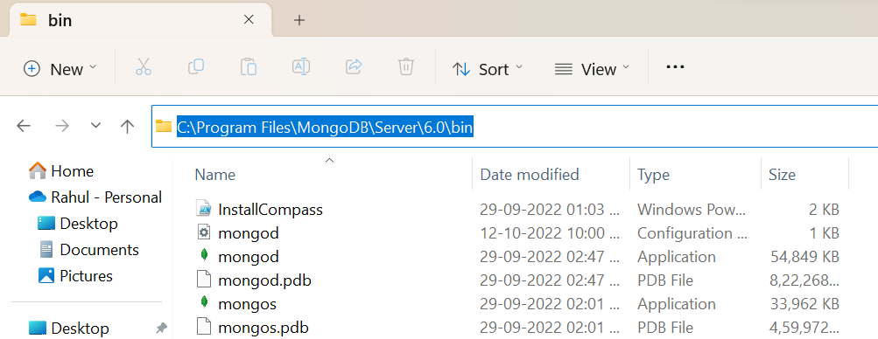
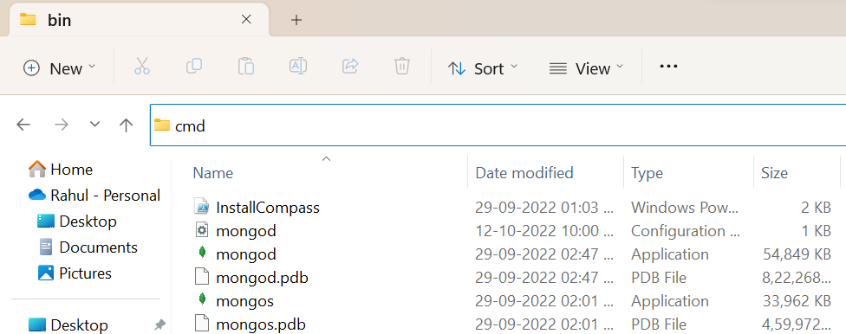
Start Server
Click on address bar and type cmd and press enter

Slide 6
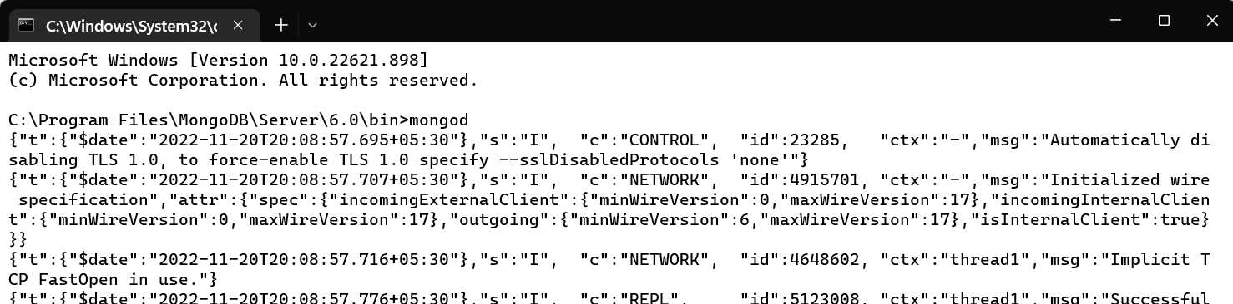
Start Server
Click on address bar and type cmd and press enter
A command prompt will open and type “mongod” and minimize this window

Slide 7
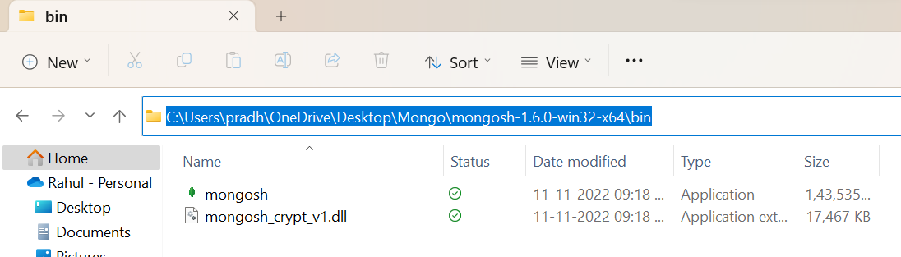
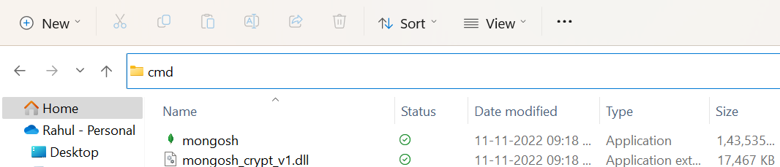
Start Client
Download mongo shell using link: Mongo Shell
Unzip and extract all in a folder
Go to bin in extracted folder
Open cmd from address bar

Slide 8
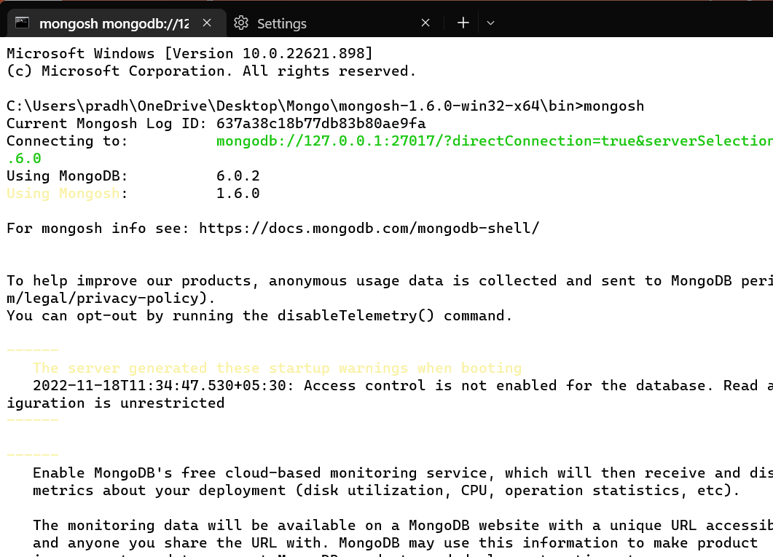
Start Client
Download mongo shell using link: Mongo Shell
Unzip and extract all in a folder
Go to bin in extracted folder
Open cmd from address bar
A window like this will open
Type “mongosh”

Slide 9
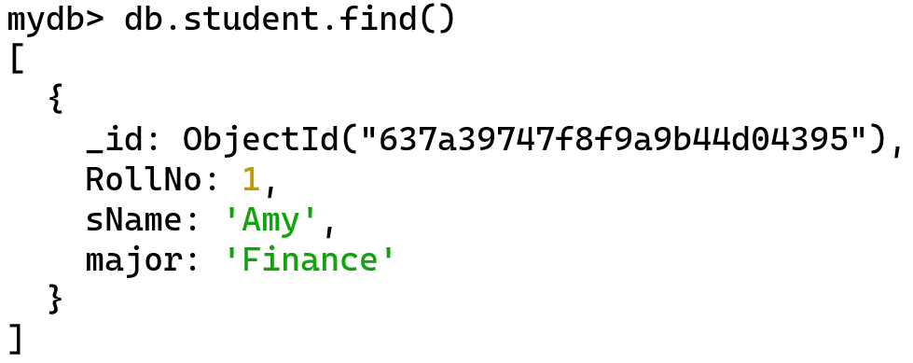
Insert
Insert or add the following document in student collection
Ans:
Output for reference

Slide 10
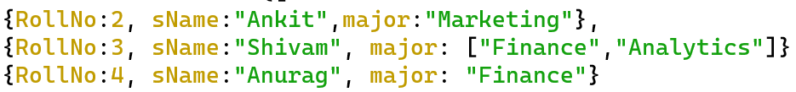
Convert the following into JSON Documents
RollNo | sName | major
2 | Ankit | Marketing
3 | Shivam | Finance, Analytics
4 | Anurag | Finance
We have added square bracket as it has more than one value so we convert it into array in other two documents of Ankit and Anurag don’t have these square brackets as they have only one value in major

Slide 11
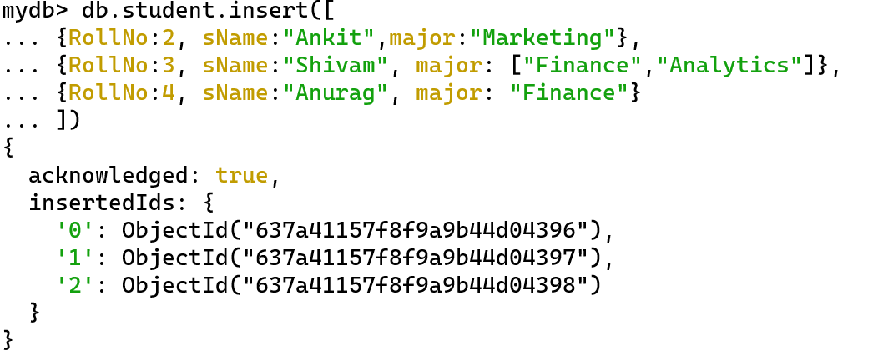
Insert the following documents using single command

Slide 12
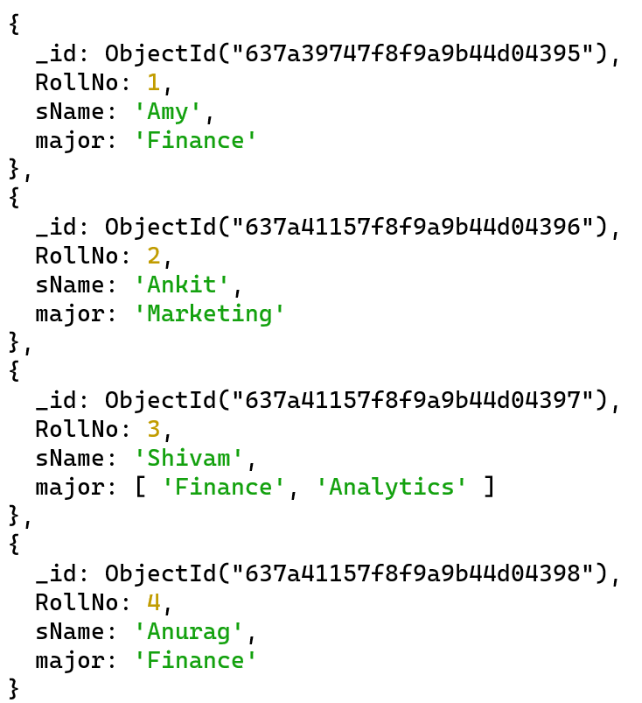

display all records of student collection
Output
All 4 documents will be displayed

Slide 13
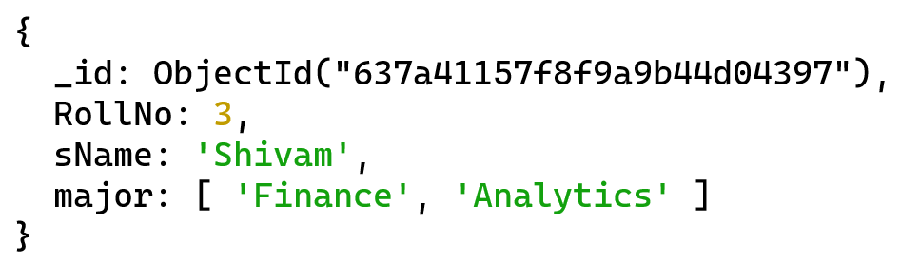
display record of student name “Shivam” only.
Output
Only document of shivam is displayed

Slide 14
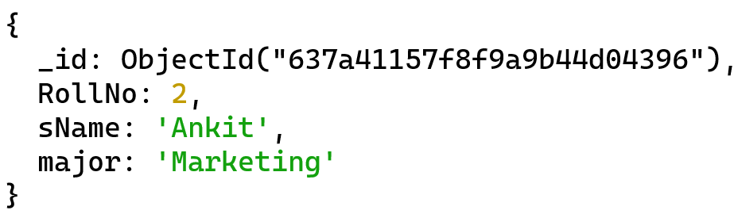
display record of 2 roll no.
Output
Only document of rollno 2 is displayed

Slide 15
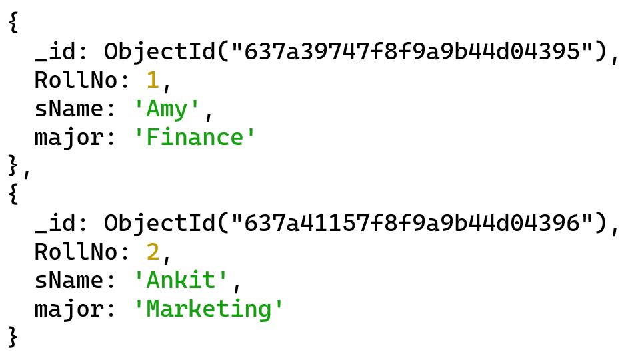
display record of first two students only
Output
Only first 2 documents is displayed

Slide 16

Display number of students
4
As there are only 4 documents

Slide 17

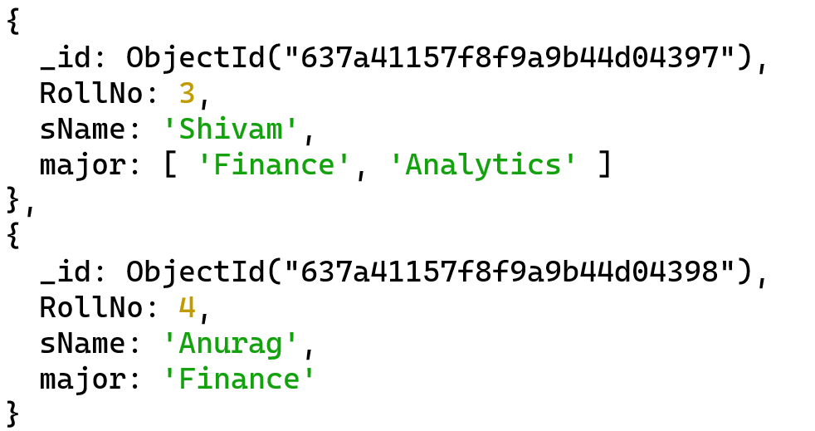
Display records of all students other than first 2 students
Output
Documents for rollno 1 and 2 is not displayed as they were skipped

Slide 18
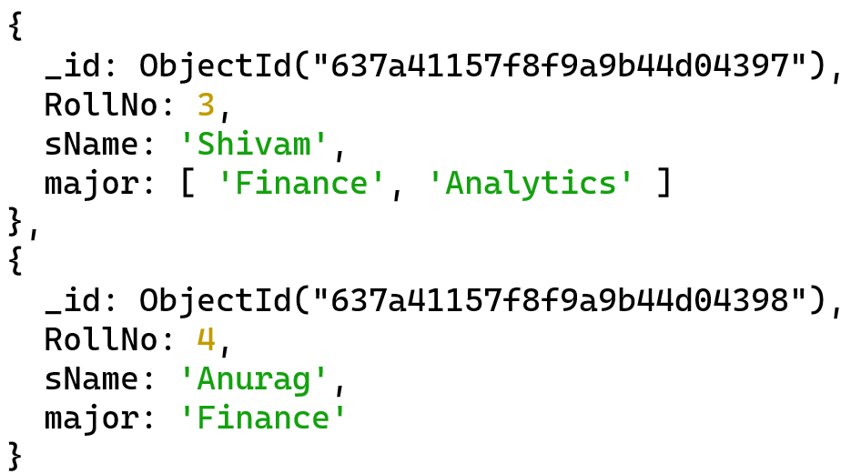
Display last 2 records
Output
Documents for rollno 3 and 4 is displayed as they are last 2 documents out of 4 documents in collection

Slide 19
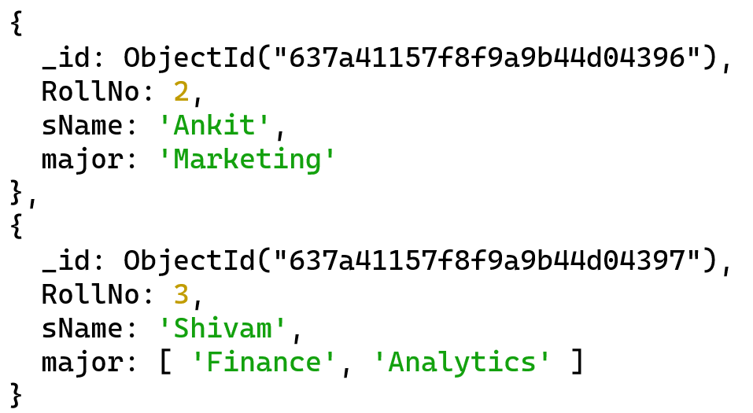
Display only 2nd and 3rd documents
Output
Documents for rollno 2 and 3 is displayed as they are 2nd and 3rd document
We have skiped first doc and then limit the output to only two documents

Slide 20
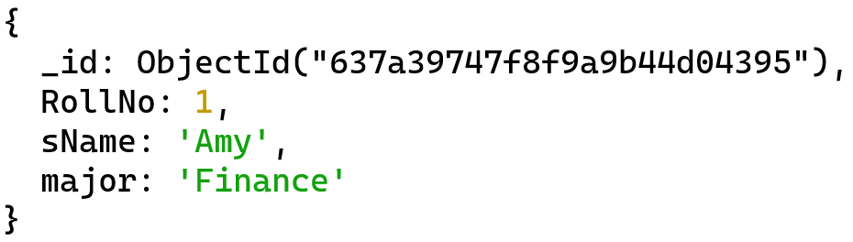
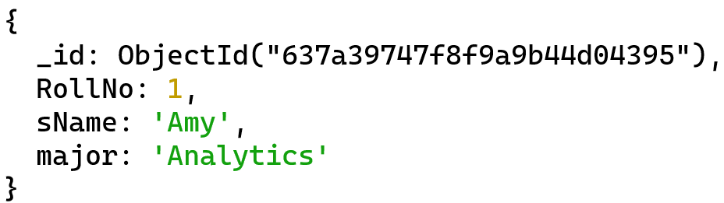
Update amy major from finance to analytics
BEFORE
AFTER

Slide 21
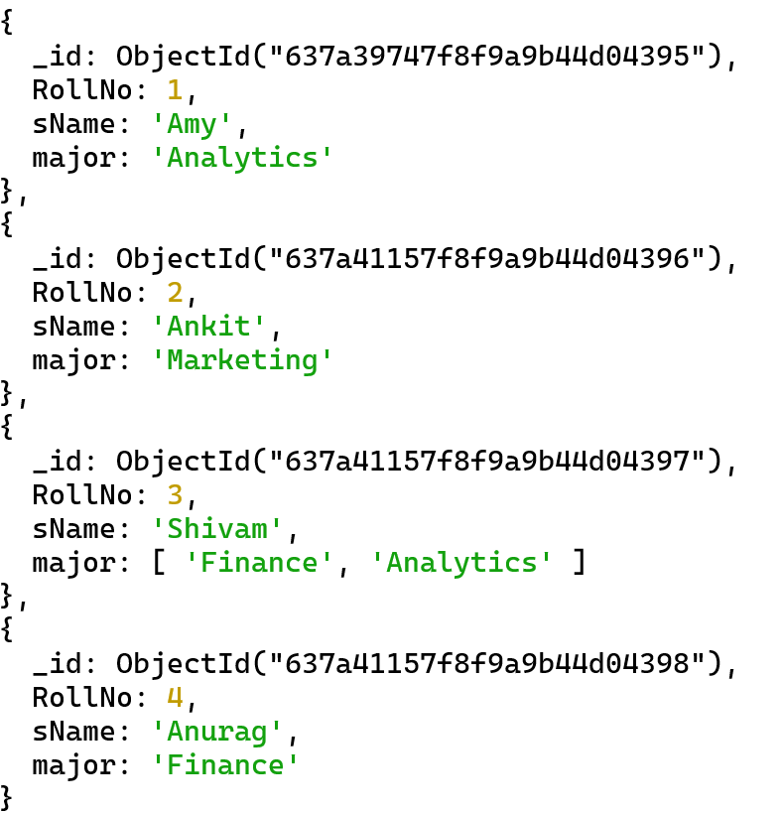
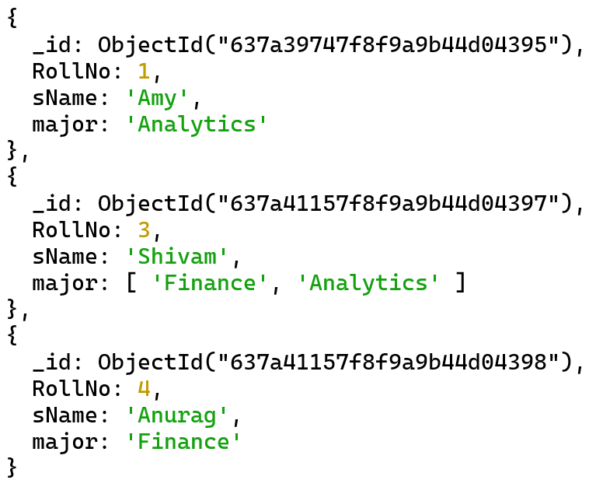
remove record of roll no 2
AFTER
Document 2 deleted now!
BEFORE

Slide 22

remove all records of student collection.
AFTER
Collection is empty now
It has no documents
BEFORE

